Slide 1

Optimizing Cosmetic Formulations Using
Product Reformulation Trends
Olivia Folly-Gah
Notes:
How can we leverage data science to prioritize safety while driving innovation in cosmetics?

Slide 2

Project Overview
The cosmetics industry is constantly evolving, with companies reformulating products to address safety concerns, meet regulations, and align with consumer demand for clean beauty. This project explores trends in these reformulations to improve cosmetic formulation strategies.
Notes:
DONE

Slide 3
Table of contents
01
02
Introduction
Data Science Approach
03
04
Domain Insights
Future Steps
Objective of the Project
Data Science Material & Challenges Encountered and Problem-Solving
Research in Cosmetic Chemistry
Plan for Next Semester

Slide 4
01
Introduction
Background and Goals

Slide 5

Why Focus on Cosmetics?
Overview of the Industry:
The cosmetics market is valued at over $500 billion globally and impacts millions of consumers daily.
Importance of Safety in Cosmetics:
Safety is regulated by laws like the California Safe Cosmetics Act, requiring transparency for hazardous ingredients.
Reformulations arise due to regulatory updates, safety concerns, and consumer demands for cleaner products.
Notes:
DONE
Relevance to Data Science:
Analyzing reformulation trends offers insights into industry shifts and opportunities for innovation.

Slide 6

Objective
Enhancing Cosmetic Formulation Strategies
Relevance to Data Science
Analyze cosmetic reformulation trends using stats and machine learning to uncover safety, regulatory, and market-driven patterns.
Tracks ingredient reformulations with stats and machine learning to predict trends and aid safer, innovative cosmetics.
Notes:
"Today's objective is to enhance cosmetic formulation strategies by analyzing reformulation trends. We'll use statistics and machine learning to uncover key patterns related to safety, regulatory compliance, and market demand. This approach helps track ingredient changes, predict future trends, and ultimately support the development of safer and more innovative cosmetics."

Slide 7
02
Data Science Approach
Cleaning Process and Challenges

Slide 8

Data Cleaning
Challenges
Actions Taken
Example Features
Missing reformulation dates and inconsistent chemical or company names (e.g., typos, synonyms).
Standardized chemical names with CAS Numbers.
Mapped CAS Numbers to Prop 65 for hazard scores.
Calculated reformulation frequency from chemical updates.
Hazard Score: "Methylparaben: 7, Formaldehyde: 9."
Reformulation: "Yes/No."
Notes:
"Proposition 65 is a California law that requires companies to warn consumers if their products contain chemicals known to cause cancer, birth defects, or reproductive harm."
When cleaning the data, we faced challenges such as missing reformulation dates and inconsistent chemical or company names, often due to typos or synonyms. To address this, we standardized chemical names using CAS numbers and mapped these to Prop 65 hazard scores. We also calculated reformulation frequency based on chemical updates.
Some example features include hazard scores, like 'Methylparaben: 7' or 'Formaldehyde: 9,' and reformulation status, which is marked as 'Yes' or 'No.'

Slide 9
Before and After
Before Cleaning
After Cleaning
Column Name | Before Cleaning (Original) | After Cleaning (Cleaned)
ChemicalName | "Methylparaben, Methyl 4-hydroxybenzoate" | Methylparaben
 | “Sodium Chloride (Salt)” | Sodium Chloride
CompanyName | “Glow Cosmetics, LLC" | Glow Cosmetics
Redundant chemical names with full descriptions
Inconsistent naming conventions (e.g., company suffixes such as "Inc." vs "Ltd." vs "LLC").
Removed suffixes, extra punctuations, and spaces.

Slide 10
Feature Engineering
HazardType
ReformulationCount
01
02
03
04
ChemicalName
Chemical Age
Track how many times a product has been reformulated
Categorize chemicals based on regulations.
Jupiter is the biggest planet of them all
Calculate the age of each chemical from its creation date to the current date

Slide 11
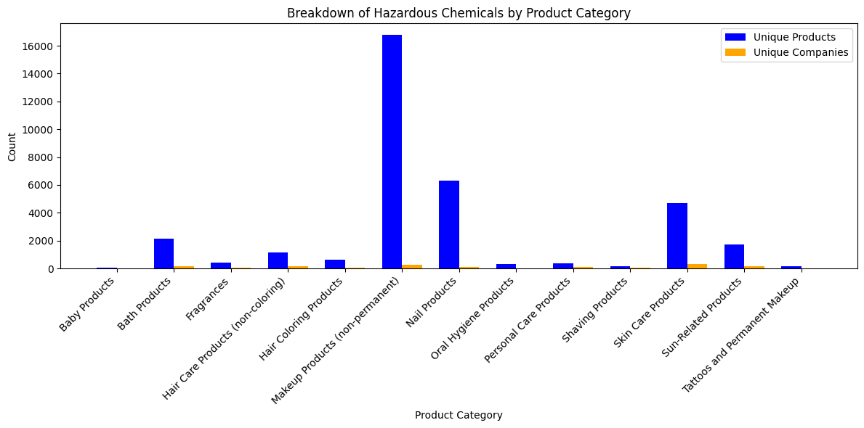
Exploratory Data Analysis (EDA)....
Baby Products
Makeup
Timeline of Discontinuations
Lowest discontinuation rate, reflecting stricter safety standards in initial formulation.
Shows highest discontinuation trend, likely due to bans (e.g., pigments, talc) and changing consumer preferences.
Discontinuation peaks align with regulatory changes and consumer demand for transparency.
Notes:
Examining trends in product reformulations and discontinuations.

Slide 12
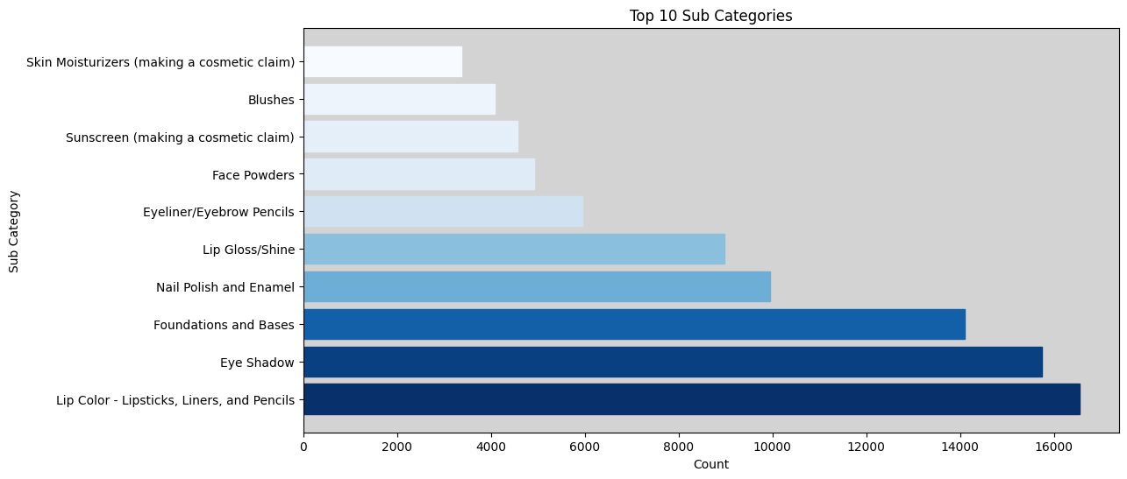
Ranking of the top 10 cosmetic subcategories by the presence of hazardous chemicals.
Notes:
This bar chart highlights that 9 out of the top 10 subcategories with hazardous ingredients are in the Makeup category. This points to a need for focused reformulation efforts within Makeup to improve consumer safety. The chart provides a clear starting point for identifying which subcategories require the most attention in terms of safety and regulatory compliance.

Slide 13

Adapting to Change: Challenges in Product Discontinuations
Makeup Products
Baby Products
Driver: Regulatory scrutiny over ingredients like talc and synthetic pigments.
Impact: Makeup leads in discontinuations, with smaller brands struggling to adapt due to limited R&D resources.
Driver: Stringent safety standards in initial formulations.
Impact: Lowest discontinuation rate, highlighting their proactive compliance with safety expectations.
Notes:
Discontinuation trends reveal significant challenges for certain product categories and brands in responding to evolving regulations and consumer preferences.

Slide 14
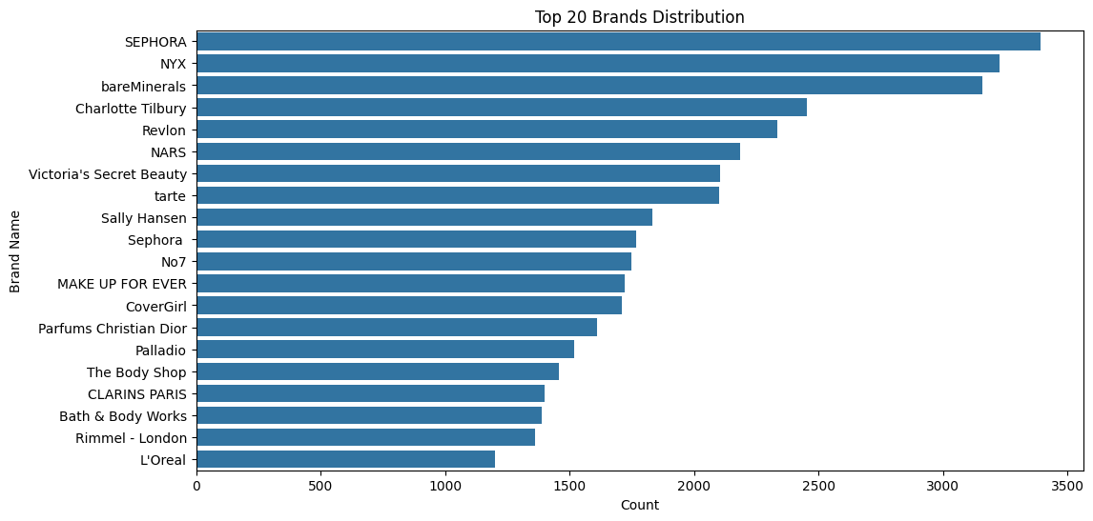
Top 20 Brands in Cosmetic Dataset
Notes:
Larger Product Portfolios = Higher Discontinuation Rates
Brands with diverse product lines are more likely to discontinue underperforming items.
Key Insight: "A larger portfolio increases exposure to regulatory changes and market shifts, leading to more discontinuations."
Proactive Adaptation to Regulations
Leading brands quickly discontinue non-compliant or controversial products to protect their reputation.
Key Insight: "Brands discontinue harmful products to stay ahead of regulations and maintain consumer trust."
Responding to Consumer Trends
Popular brands must keep up with changing consumer preferences, like clean beauty.
Key Insight: "Discontinuations reflect efforts to meet consumer demand for safer, trendier products."
Marketing and Rebranding Strategies
Brands may discontinue products as part of planned rebranding or innovation cycles.
Key Insight: "Discontinuations can be strategic moves to refresh the product line and create exclusivity."

Slide 15
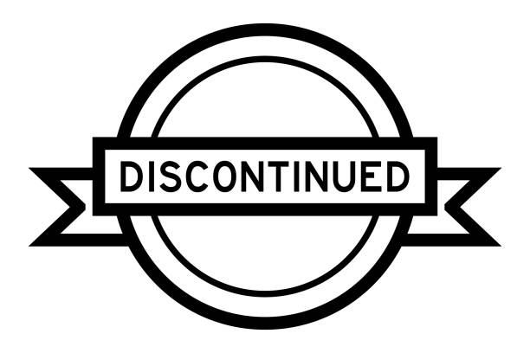
Why Popular Brands Lead in Discontinuations
Key Findings:
Large product portfolios increase discontinuation likelihood.
Proactive response to regulations and consumer scrutiny.
Strategic discontinuations to innovate and rebrand
Conclusion:
Leading brands use discontinuation as a tool for adaptation, ensuring they remain competitive and aligned with market demands.

Slide 16
Correlations Between Reformulations and Regulations
Key Questions
Correlation:
Products containing chemicals classified as confirmed carcinogens (e.g., coal tar distillates, titanium dioxide) show a moderate positive correlation with reformulation likelihood (r = 0.70).
Lag Time:
The lag time between regulation updates and product reformulations also shows a moderate positive correlation (r = 0.70). This indicates that reformulations typically occur after a regulatory update, with a delay of around 6-12 months.
Are products with banned chemicals more likely to be reformulated?
What is the lag time between a regulation update and reformulation?
Notes:
…meaning that these products have a significantly higher chance of being reformulated when they contain confirmed carcinogens.

Slide 17
Table of Correlation
Metric | Correlation (r)
Hazard Score ↔ Reformulation Likelihood | 0.70
Lag Time ↔ Reformulation Likelihood | 0.70
~ Delayed Responses: Reformulations tend to follow regulatory changes with a notable delay, suggesting that companies take time to adjust products after regulations are updated.

Slide 18

Applying Naive Bayes Classification to Cosmetic Formulations
Objective
Dataset
Naive Bayes Model
Advantages
Classify products as Safe vs Hazardous or Reformulated vs Not Reformulated based on ingredient data.
Features: Ingredients (binary presence/absence) and hazard scores.
Target: Reformulation status or safety category (Safe, Moderate, Hazardous).
Predicts reformulation or hazard likelihood based on ingredient presence.
Hazardous chemicals increase reformulation chances.
Efficient and scalable for large datasets.
Probabilistic outputs offer insights into the likelihood of reformulation or safety.
Notes:
Example Product Classification:
Product 1 (contains Methylparaben, Phthalates) → Class: Reformulated, Hazardous.
Product 2 (contains Aloe Vera, Vitamin C) → Class: Not Reformulated, Safe.
Objective:
The goal is to classify cosmetic products as either Safe vs Hazardous or Reformulated vs Not Reformulated based on ingredient data.
Dataset:
Features include ingredient presence/absence and hazard scores.
The target is Reformulation status or safety category (Safe, Moderate, Hazardous).
Naive Bayes Model - Advantages:
Predicts the likelihood of reformulation or hazard based on ingredient data.
Key Insight: Hazardous chemicals increase the likelihood of reformulation.
It's efficient and scalable, making it ideal for large datasets.
Provides probabilistic outputs, giving insights into the likelihood of reformulation or safety.

Slide 19
Challenges Encountered and Problem-Solving
Challenge 1: Shifting Objective
Original Goal: Develop safer cosmetic formulas for marginalized communities with curly/coily hair and melanated skin.
Issue: The dataset lacked specific data on these communities and their unique needs.
Solution: Shifted focus to analyzing reformulation trends and ingredient safety, adding numerical columns for analysis.
Challenge 2: Ingredient Data Complexity
Issue: Inconsistent chemical names and CAS numbers.
Solution: Standardized the data for clearer analysis.
Challenge 3: Lack of Regulatory Data
Issue: Missing regulatory information to understand ingredient changes.
Solution: Supplemented with external regulatory databases.
Notes:
Conclusion:
Original Objective: Focus on marginalized communities.
Current Focus: Ingredient reformulation trends and safety, requiring dataset adjustments.

Slide 20

03
Domain Insights
Connecting the analysis with the cosmetic industry

Slide 21
Insights from Cosmetic Chemistry Research
Regulatory Influence on Reformulations
Consumer Demand for Safety
Industry Challenges in Reformulation
Global regulations, such as EU bans on harmful chemicals (e.g., parabens, phthalates), force companies to reformulate products to meet safety standards.
The "clean beauty" movement has driven consumer demand for transparency, encouraging brands to remove harmful chemicals and prioritize safer formulations.
Cosmetic companies face challenges balancing product safety with performance and navigating the complexities of substituting ingredients without compromising efficacy.

Slide 22

04
Future Steps
Plan for Spring Semester

Slide 23
Implementation Plan
Integrate Full Dataset:
Incorporate the dataset from my industry partner, which now includes more numerical columns (e.g., pH levels, usage rates), allowing me to return to my original goal of developing safer cosmetic formulas for marginalized communities.
Interactive Tableau Visuals:
Before diving into machine learning, I'll focus on creating an interactive Tableau dashboard to visualize key findings from this semester, highlighting reformulation trends and ingredient safety.
Machine Learning Implementation:
After visualization, I'll apply clustering and classification techniques to explore product reformulation patterns and identify factors driving ingredient changes.

Slide 24
Work Cited
Major for College: Cosmetology | Google Slides and PowerPoint. slidesgo.com/theme/community-family-personal-services-major-for-college-cosmetology#search-cosmetic&position-4&results-206&rs=search&rs=search.
Rosenstein, Olivia Fleming &. Jenna. “The Ultimate Guide to Clean Beauty.” Harper’s BAZAAR, 22 Apr. 2020, www.harpersbazaar.com/beauty/skin-care/a28352553/clean-beauty.
“Scientific Opinion on the Hazard Assessment of Endocrine Disruptors: Scientific Criteria for Identification of Endocrine Disruptors and Appropriateness of Existing Test Methods for Assessing Effects Mediated by These Substances on Human Health and the Environment.” EFSA Journal, vol. 11, no. 3, Mar. 2013, doi:10.2903/j.efsa.2013.3132.
“---.” EFSA Journal, vol. 11, no. 3, Mar. 2013, doi:10.2903/j.efsa.2013.3132.
Xu, Shaohua, et al. “Hair Chemicals May Increase Breast Cancer Risk: A Meta-analysis of 210319 Subjects From 14 Studies.” PLoS ONE, vol. 16, no. 2, Feb. 2021, p. e0243792, doi:10.1371/journal.pone.0243792.

Slide 25

Thank You!
Any Questions?

